Slide 1
The Nature of Light
Before the beginning of the nineteenth century, light was considered to be a stream of particles
The particles were either emitted by the object being viewed or emanated from the eyes of the viewer
Newton was the chief architect of the particle theory of light
He believed the particles left the object and stimulated the sense of sight upon entering the eyes

Slide 2
Nature of Light – Alternative View
Christian Huygens argued that light might be some sort of a wave motion

Slide 3
Young’s Contribution
Thomas Young (1801) provided the first clear demonstration of the wave nature of light
He showed that light rays interfere with each other
Such behavior could not be explained by particles

Slide 4
Modern Scriptural Comments on Nature of Light
In September of 1832 Joseph Smith received a revelation that said in part :
For the word of the Lord is truth, and whatsoever is truth is light, and whatsoever is light is Spirit, even the Spirit of Jesus Christ. And the Spirit giveth light to every man that cometh into the world; and the Spirit enlighteneth every man through the world, that hearkeneth to the voice of the Spirit. (D&C 84:45-46)

Slide 5
Modern Scriptural Comments on Nature of Light
In December of 1832 Joseph Smith received another revelation that says in part:
This Comforter is the promise which I give unto you of eternal life, even the glory of the celestial kingdom; which glory is that of the church of the Firstborn, even of God, the holiest of all, through Jesus Christ his Son---He that ascended up on high, as also he descended below all things, in that he comprehended all things, that he might be in all and through all things, the light of truth; which truth shineth. This is the light of Christ. As also he is in the sun, and the light of the sun, and the power thereof by which it was made. As also he is in the moon, and is the light of the moon, and the power thereof by which it was made; as also the light of the stars, and the power thereof by which they were made; and the earth also, and the power thereof, even the earth upon which you astand. And the light which shineth, which giveth you light, is through him who enlighteneth your eyes, which is the same light that quickeneth your understandings; which light proceedeth forth from the presence of God to fill the immensity of space---the light which is in all things, which giveth life to all things, which is the law by which all things are governed, even the power of God who sitteth upon his throne, who is in the bosom of eternity, who is in the midst of all things. (D&C 88:5-12 emphasis added)

Slide 6
More Confirmation of Wave Nature
During the nineteenth century, other developments led to the general acceptance of the wave theory of light
Maxwell asserted that light was a form of high-frequency electromagnetic wave
Hertz confirmed Maxwell’s predictions

Slide 7
Particle Nature
Some experiments could not be explained by the wave nature of light
The photoelectric effect was a major phenomenon not explained by waves
When light strikes a metal surface, electrons are sometimes ejected from the surface
The kinetic energy of the ejected electron is independent of the frequency of the light

Slide 8
e
e
e
e
Big Battery

Slide 9
zzzzzzzzzzzzzzzzzzzzzzzz
Electron
Nucleus with protons and neutrons
Electron
Particles not drawn to scale

Slide 10
Outgoing Electron
Incoming photon

Slide 11
Particle Nature, cont.
Einstein (in 1905) proposed an explanation of the photoelectric effect that used the idea of quantization
The quantization model assumes that the energy of a light wave is present in particles called photons
E = hƒ
h is Planck’s Constant and = 6.63 x 10⁻³⁴ J.s

Slide 12
Dual Nature of Light
In view of these developments, light must be regarded as having a dual nature
Light exhibits the characteristics of a wave in some situations and the characteristics of a particle in other situations
Nature prevents testing both qualities at the same time

Slide 13
Measurement of the Speed of Light

Slide 14
Measurements of the Speed of Light
Since light travels at a very high speed, early attempts to measure its speed were unsuccessful
Remember c = 3.00 x 10⁸ m/s
Galileo tried by using two observers separated by about 10 km
The reaction time of the observers was more than the transit time of the light

Slide 15
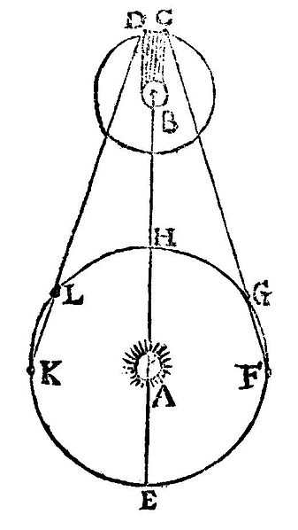
Measurement of the Speed of Light – Roemer’s Method
Ole Roemer (1675) used astronomical observations to estimate the speed of light
He used the period of revolution of Io, a moon of Jupiter, as Jupiter revolved around the sun
In the diagram illustrating Rømer's determination of the speed of light. A: The Sun B: Jupiter C: immersion of Io into Jupiter's shadow at the start of an eclipse D: emergence of Io from Jupiter's shadow at the end of an eclipse E–H, K, L: positions of Earth at different dates (illustrative) E: point of conjunction H: point of opposition

Slide 16
Roemer’s Method, cont.
The periods of revolution were longer when the Earth was receding from Jupiter
and shorter when the Earth was approaching
Using Roemer’s data, Huygens estimated the lower limit of the speed of light to be 2.3 x 10⁸ m/s
This was important because it demonstrated that light has a finite speed as well as giving an estimate of that speed

Slide 17
Measurements of the Speed of Light – Fizeau’s Method
This was the first successful method for measuring the speed of light by means of a purely terrestrial technique
It was developed in 1849 by Armand Fizeau
He used a rotating toothed wheel
The distance between the wheel (considered to be the source) and a mirror was known

Slide 18
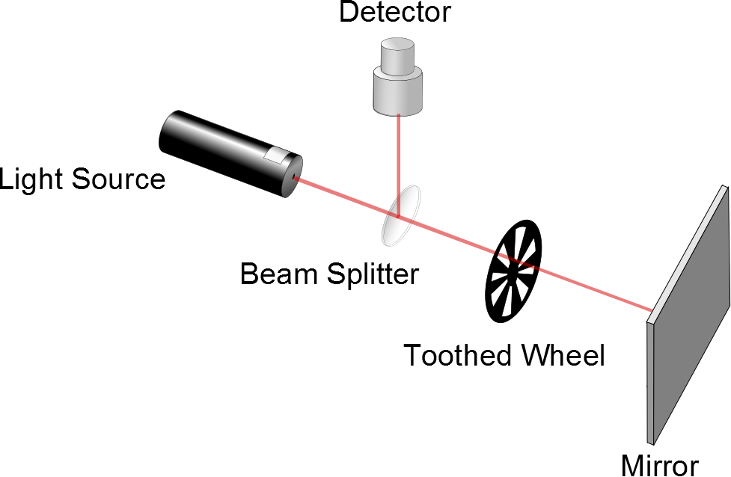
Fizeau’s Method, cont.
d is the distance between the wheel and the mirror
Δt is the time for one round trip
Then c = 2d / Δ t
Fizeau found a value of
c = 3.1 x 10⁸ m/s
Movie

Slide 19
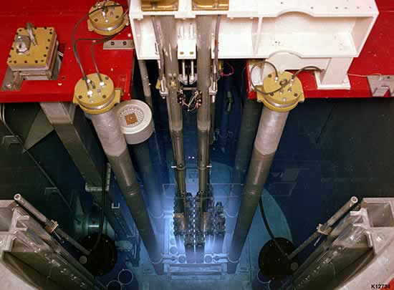
Faster than light?

Slide 20
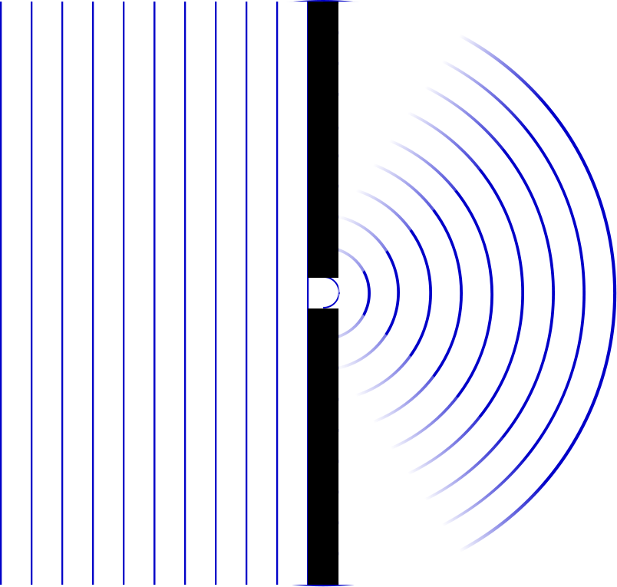

Slide 21
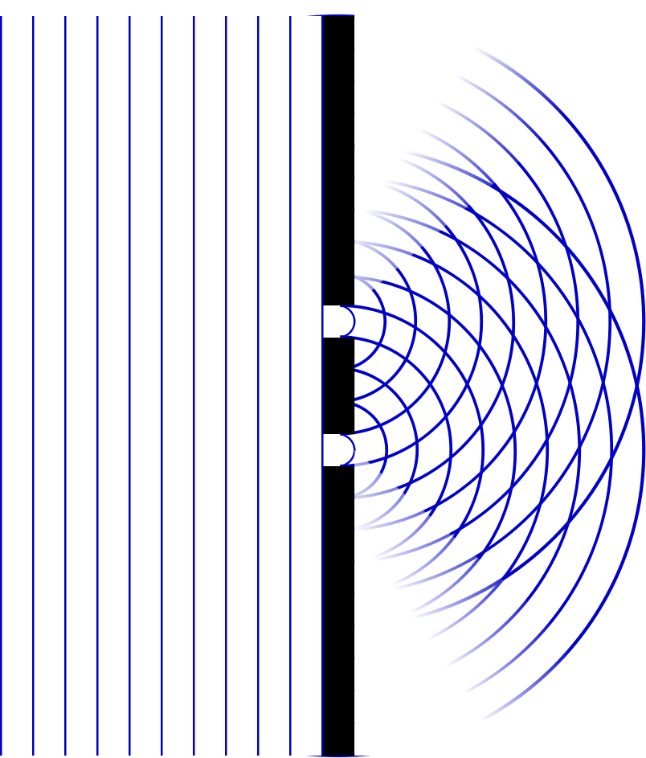

Slide 22
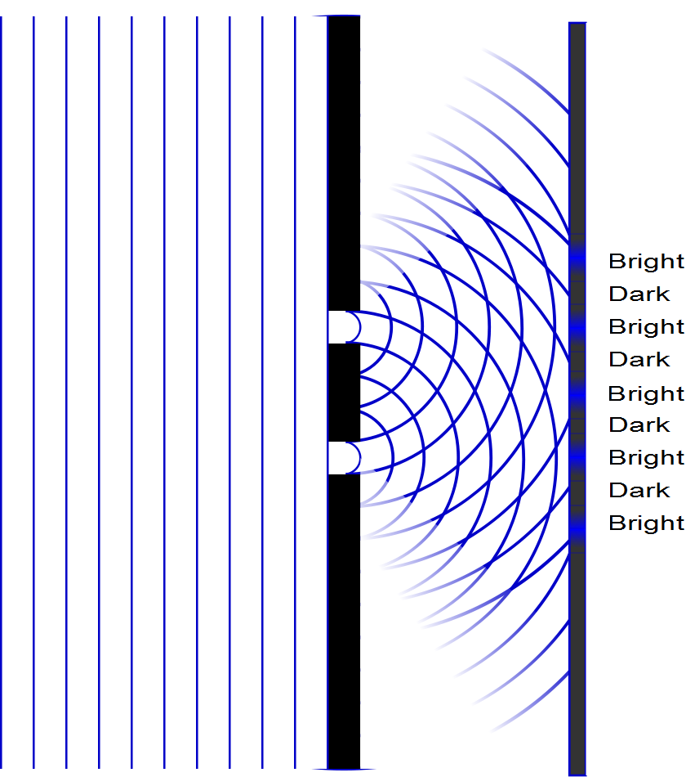

Slide 23
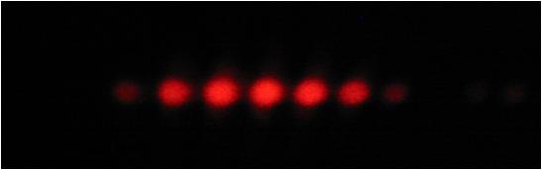

Slide 24
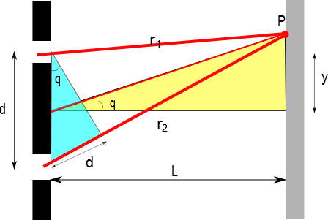
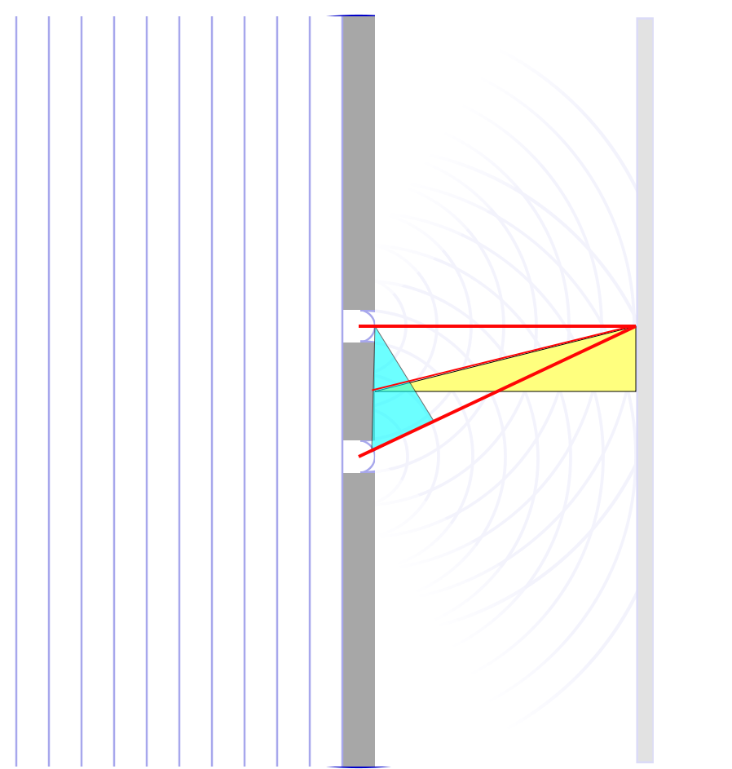

Slide 28
I
Interference fringes:
due to having two slits.
φ/2
-5π
-3π
-π
π
3π
5π

